Slide 1
Computer Graphics Lecture 04 Filling Area

Slide 2
Polygon Representation
The polygon can be represented by listing its n vertices in an ordered list.
P = {(x₁, y₁), (x₂, y₂), ……., (x_{n}, y_{n})}.
The polygon can be displayed by drawing a line between (x₁, y₁), and (x₂, y₂), then a line between (x₂, y₂), and (x₃, y₃), and so on until the end vertex. In order to close up the polygon, a line between (x_{n}, y_{n}), and (x₁, y₁) must be drawn.
One problem with this representation is that if we wish to translate the polygon, it is necessary to apply the translation transformation to each vertex in order to obtain the translated polygon.

Slide 3
Polygon Types
Polygons can be divided into three basic types: convex, concave, and complex.

Slide 4
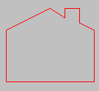

Concave
The polygon edges may also touch each other, but they may not cross one another.

Slide 5
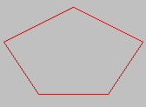
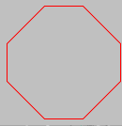
Convex
Does a straight line connecting ANY two points that are inside the polygon intersect any edges of the polygon?

Slide 6
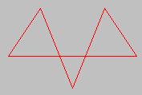

Complex
Complex polygons are basically concave polygons that may have self-intersecting edges. The complexity arises while distinguishing which side is inside the polygon when filling it.

Slide 7
Parity Requirement
In order to determine which pixels are inside the polygon, the odd-parity rule is used within the scan-line polygon fill algorithm.

Slide 8
Parity
Draw a line segment from any point that lies outside the polygon to a point P.
Count the number of edges that the line crosses. If the number of polygon edges crossed is odd, then P lies within the polygon. Whereas, if the number of edges is even, then P lies outside the polygon.

Slide 9
Inside-Outside Tests
The point is considered to be interior if the number of intersections between the line and the polygon edges is odd. Otherwise, The point is exterior point.
Outside
8
7
6
5
4
3
2
1
0
0
1
2
3
4
5
6
7
8
9
10
11
Inside

Slide 10
Polygon Filling
What is Polygon filling?
🡺 Highlight all the pixels in the polygon with any color other
than the background.
Types of Polygon filling ( 2 approaches)
Seed Fill:
Boundary Filling:
Flood Filling: Select interior point - Paint outwards
Scan-line : Scan lines between Boundaries and color the pixels that lies inside the polygon.

Slide 11
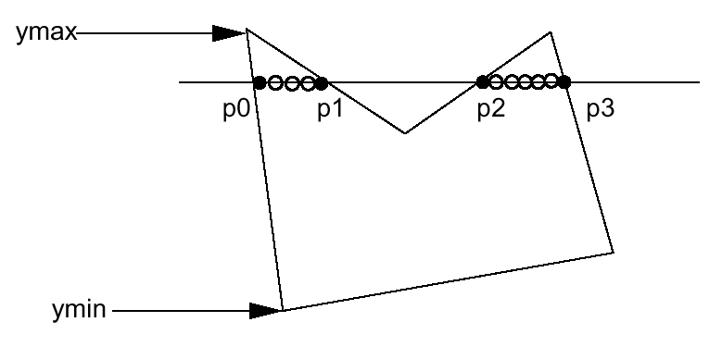
Scanline Fill Algorithm
Intersect scanline with polygon edges
Fill between pairs of intersections
Basic algorithm: For y = ymin to ymax 1) intersect scanline y with each edge 2) sort intersections by increasing x [p0,p1,p2,p3] 3) fill pairwise (p0->p1, p2->p3, …)

Slide 12
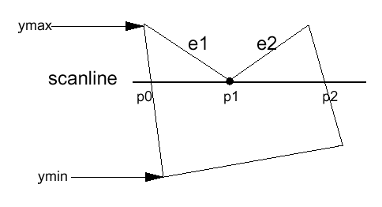
Spacial Handling (cont.)
Intersection is an edge end point
Case 1
Intersection points: (p0, p1, p2) ???
->(p0,p1,p1,p2) so we can still fill pairwise
->In fact, if we compute the intersection of the scanline with edge e1 and e2 separately, we will get the intersection point p1 twice. Keep both of the p1.

Slide 13
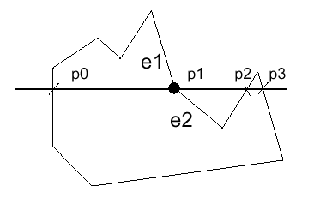
Spacial Handling (cont.)
Case 2
However, in this case we don’t want to count p1 twice (p0,p1,p1,p2,p3), otherwise we will fill pixels between p1 and p2, which is wrong.

Slide 14
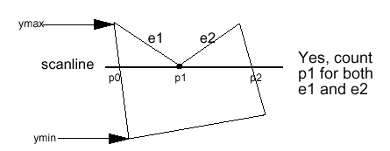
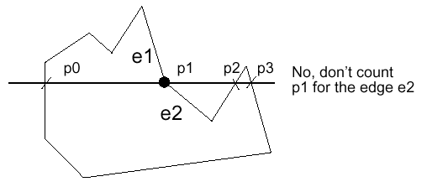
Spacial Handling (cont.)
Summary: If the intersection is the ymin of the edge’s endpoint, count it. Otherwise, don’t.
Both edges are in the same side of the scan line
Both edges are in the opposite side of the scan line
Fix a new start point for e2

Slide 15
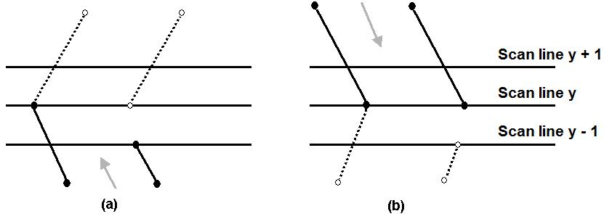
The Scan-Line Polygon Fill Algorithm
Dealing with vertices
When the endpoint y coordinates of the two edges are monotonously increasing, the y value of the upper endpoint for the current edge is decreased by one (a)
When the endpoint y values are monotonously decreasing, the y value of the next edge is decreased by one (b)

Slide 16
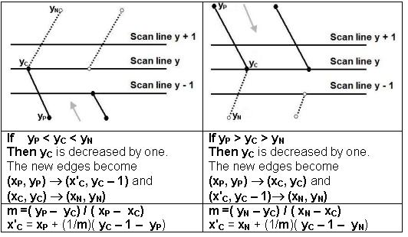
The Scan-Line Polygon Fill Algorithm
(Example)
N.B. x2=x1+1/m(y2-y1)

Slide 17
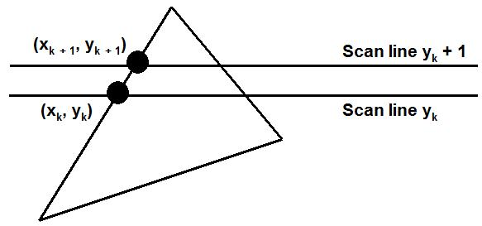
The Scan-Line Polygon Fill Algorithm
Determining Edge Intersections
m = (y_{k+1} – y_{k}) / (x_{k+1} – x_{k})
y_{k+1} – y_{k} = 1
x_{k+1} = x_{k} + 1/m

Slide 18
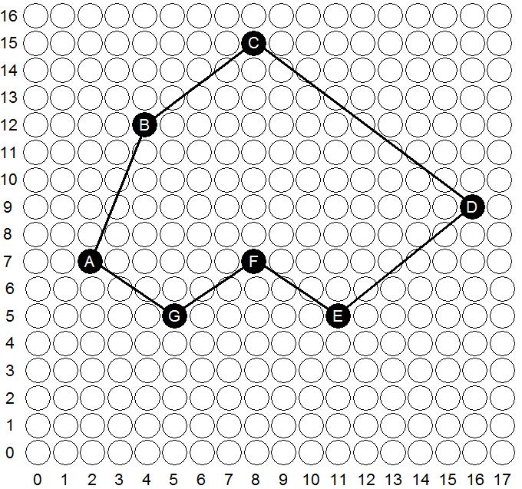
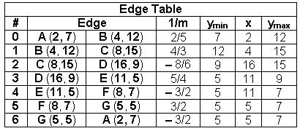
The Scan-Line Polygon Fill Algorithm
(Example) Polygon = {A, B, C, D, E, F, G}
Polygon = {(2, 7), (4, 12), (8,15), (16, 9), (11, 5), (8, 7), (5, 5)}

Slide 19
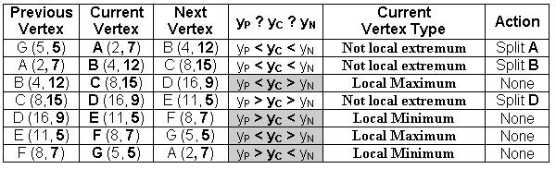
The Scan-Line Polygon Fill Algorithm(Example)
Vertex A should be split into two vertices A' (x_{A'}, 6) and A(2, 7)
m =( 5 – 7)/( 5 – 2) = – 2/3
x'_{A} = 5 + (–3/2)( 7 – 1 – 5) = 7/2 = 3.5 ≅ 4
The vertex A is split to A' (4, 6) and A(2, 7)

Slide 20
The Scan-Line Polygon Fill Algorithm(Example)
Vertex B should be split into two vertices B' (x_{B'}, 11) and B(4, 12)
m =( 7 – 12)/( 2 – 4) = 5/2
x'_{A} = 2 + (2/5)( 12 – 1 – 7) = 18/5 = 3.6 ≅ 4
The vertex B is split to B' (4, 11) and B(4, 12)

Slide 21
The Scan-Line Polygon Fill Algorithm(Example)
Vertex D should be split into two vertices D(16, 9) and D' (x_{D'}, 8)
m =( 5 – 9)/( 11 – 16) = 4/5
x'_{D} = 11 + (5/4)( 9 – 1 – 5) = 59/4 = 14.75 ≅ 15
The vertex D is split to D(16, 9) and D' (15, 8)

Slide 22
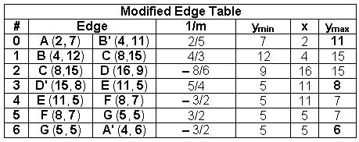

The Scan-Line Polygon Fill Algorithm(Example)

Slide 23
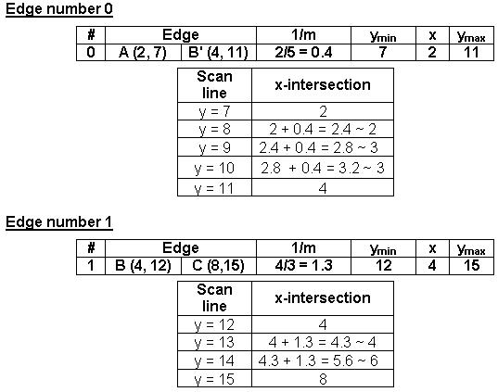
The Scan-Line Polygon Fill Algorithm(Example)

Slide 24
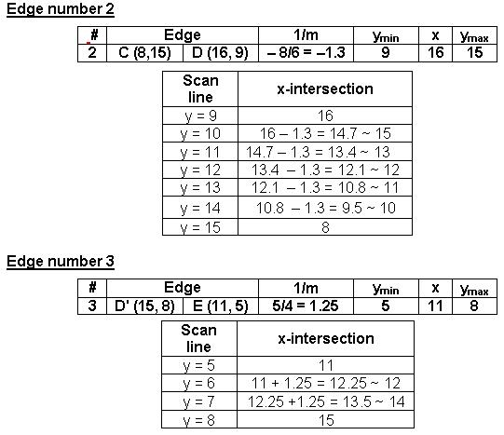
The Scan-Line Polygon Fill Algorithm(Example)

Slide 25
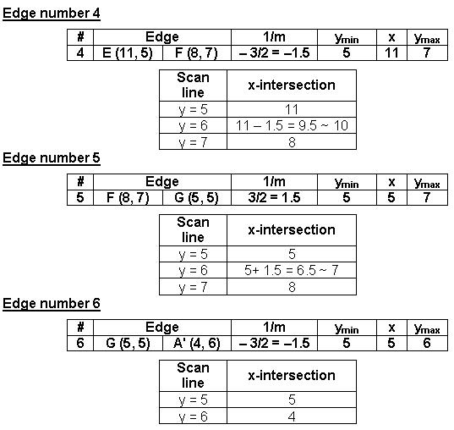
The Scan-Line Polygon Fill Algorithm(Example)

Slide 26
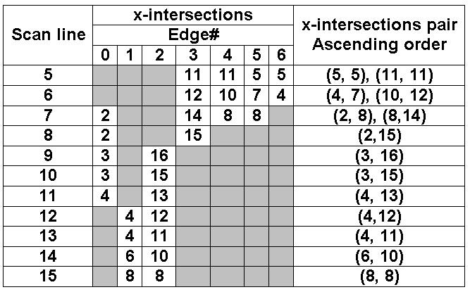
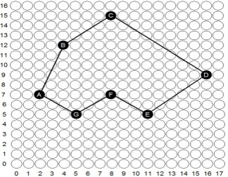
The Scan-Line Polygon Fill Algorithm(Example)

Slide 27
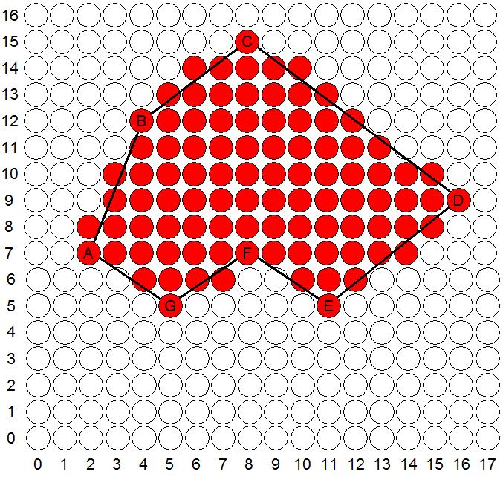
The Scan-Line Polygon Fill Algorithm
(Example)

Slide 28
Seed Fill Algorithm
Boundary-fill: Start from an interior point and paint outward from this point till the boundary is reached; called boundary-fill.
Flood-fill: Start from an interior point and start painting outward from this point till the end of cluster.

Slide 29
Polygon Filling
Seed Fill:
Boundary Filling:
Edges of the polygon is drawn first. Take a seed pixel (x,y) inside the polygon.
Find the neighboring pixels until boundary is reached
z
Seed (x,y)

Slide 30
Polygon Filling
Seed Fill:
Boundary Filling:
Edges of the polygon is drawn first. Take a seed pixel (x,y) inside the polygon.
Find the neighboring pixels until boundary is reached.
Two types of searching a) 4-connected b) 8-connected pixels
(x, y+1)
z
(x-1, y)
(x+1, y)
Seed (x,y)
(x, y-1)
4-Connected Pixels

Slide 31
Polygon Filling
Seed Fill:
Boundary Filling:
Edges of the polygon is drawn first. Take a seed pixel (x,y) inside the polygon.
Find the neighboring pixels until boundary is reached.
Two types of searching a) 4-connected b) 8-connected pixels
(x, y+1)
(x-1, y+1)
(x+1, y+1)
z
(x-1, y)
(x+1, y)
Seed (x,y)
(x+1, y-1)
(x-1, y-1)
(x, y-1)
8-Connected Pixels

Slide 32
Boundary Fill Algorithm
The following steps illustrate the idea of the recursive boundary-fill algorithm:
1. Start from an interior point.
2. If the current pixel is not already filled and if it is not an edge point, then set the pixel with the fill color, and store its neighboring pixels (4 or 8-connected) in the stack for processing. Store only neighboring pixel that is not already filled and is not an edge point.
3. Select the next pixel from the stack, and continue with step 2.

Slide 33
Boundary Fill Algorithm
4-connected (Example)
Start Position

Slide 34
Boundary Fill Algorithm
4-connected (Example)
3
2
1
1
2
3

Slide 35
Boundary Fill Algorithm
4-connected (Example)
4
2
1
1
4
2

Slide 36
Boundary Fill Algorithm
4-connected (Example)
2
1
1
2

Slide 37
Boundary Fill Algorithm
4-connected (Example)
5
1
5
1

Slide 38
Boundary Fill Algorithm
4-connected (Example)
1
1

Slide 39
Boundary Fill Algorithm
4-connected (Example)

Slide 40
Boundary Fill Algorithm
8-connected (Example)
Start Position

Slide 41
Boundary Fill Algorithm
8-connected (Example)
5
4
3
2
1
4
1
5
2
3

Slide 42
Boundary Fill Algorithm
8-connected (Example)
6
4
3
2
1
6
4
1
2
3

Slide 43
Boundary Fill Algorithm
8-connected (Example)
8
7
4
3
2
1
7
8
4
1
2
3

Slide 44
Boundary Fill Algorithm
8-connected (Example)
12
11
10
9
7
4
3
2
1
11
9
12
7
10
4
1
2
3

Slide 45
Boundary Fill Algorithm
8-connected (Example)
11
10
9
7
4
3
2
1
11
9
7
10
4
1
2
3

Slide 46
Boundary Fill Algorithm
8-connected (Example)
10
9
7
4
3
2
1
9
7
10
4
1
2
3

Slide 47
Boundary Fill Algorithm
8-connected (Example)
9
7
4
3
2
1
9
7
4
1
2
3

Slide 48
Boundary Fill Algorithm
8-connected (Example)
7
4
3
2
1
7
4
1
2
3

Slide 49
Boundary Fill Algorithm
8-connected (Example)
4
3
2
1
4
1
2
3

Slide 50
Boundary Fill Algorithm
8-connected (Example)
3
2
1
1
2
3

Slide 51
Boundary Fill Algorithm
8-connected (Example)
2
1
1
2

Slide 52
Boundary Fill Algorithm
8-connected (Example)
1
1

Slide 53
Boundary Fill Algorithm
8-connected (Example)

Slide 54
Boundary Fill Algorithm
Since the previous procedure requires considerable stacking of neighboring pixels, more efficient methods are generally employed.
These methods (Span Flood-Fill) fill horizontal pixel spans across scan lines, instead of proceeding to 4-connected or 8-connected neighboring pixels.
Then we need only stack a beginning position for each horizontal pixel spans, instead of stacking all unprocessed neighboring positions around the current position.

Slide 55
Polygon Filling Algorithm
void boundary_fill (x, y, fc, bc){
if(getpixel(x,y) != bc && getpixel(x,y) !=fc){
putpixel(x,y,fc);
boundary_fill(x+1, y, fc,bc);
boundary_fill(x, y+1, fc,bc);
boundary_fill(x-1, y, fc,bc);
boundary_fill(x, y-1, fc,bc);
}
}
(x,y): current pixel
fc: new color
bc: boundary color
getpixel(x,y): returns color of (x,y)
putpixel(x,y,c): paint (x,y) with color c

Slide 56
Polygon Filling
Seed Fill:
Flood Filling: starts from seed, old color replace by
new color. Here old color is black and new color is yellow
border color is while

Slide 57
Flood fill Function
void flood_fill(int x,int y,int newc,int oldc){
if(getpixel(x,y)==oldc){
putpixel(x,y,newc);
flood_fill(x+1,y,newc,oldc);
flood_fill(x,y+1,newc,oldc);
flood_fill(x-1,y, newc,oldc);
flood_fill(x,y-1, newc,oldc);
}

Slide 58
The End

